Slide 1

Programming Project: Syntax analyzer

Slide 2

Goal
Use the BNF grammar we discussed in the video link below.
Implement a syntax analyzer that checks grammar against a source code base.
The source code will be read from left to right to check if there are syntax errors
Integrate the lexical analyzer you created previously.

Slide 3
Grammar Rules
var_dec ::= data_type dec ;
data_type ::= boolean
::= float
::= int
::= String
::= byte
::= long
::= short
dec::= identifier [=exp]
::= identifier, dec
Exp:= exp (+|*|/|-) exp
::= ( exp )
::= a-z-A-Z [exp]
::= 0 - 9 [exp]
identifier:(a-z-A-Z) [a-z-A-Z-0-9_]

Slide 4
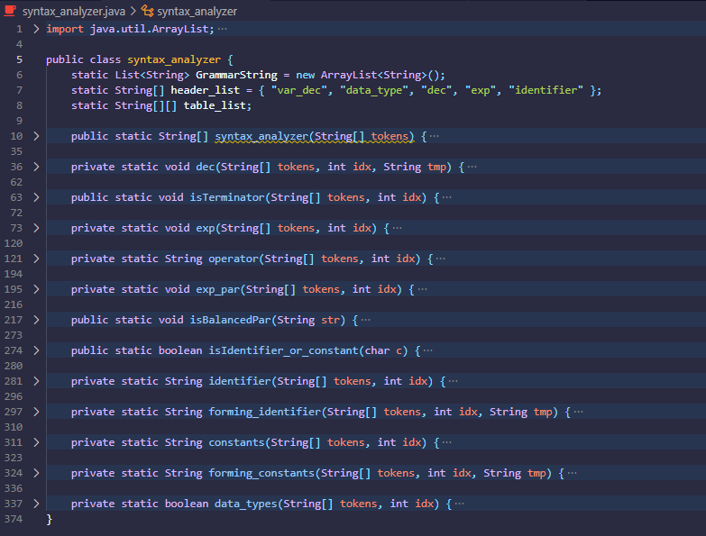
Main
Function that return s the parse tree of the given syntax code
The summary of Function use in checking the grammar if it is a valid syntax code or not.
Function that covers the choices in dec where if the tokens[2] is = or , or none
Function that checks if the last index is terminator
Function that path where choice from dec is =
Function that checks the conditions being fulfilled from <exp> <op> <exp>
Function that check if users has ( brace then copy the token from the index of ( until end
Function that check the if the token has balanced parenthesis then identify for errors
Function that return Boolean to isBalanced if certain index is identifier or constant for checking
Function that throws error if it is not identifier and return the string of successive identifier
Function that return the string of successive identifier
Function that return s the parse tree of the given syntax code
Function that throws error if it is not constant and return the string of successive identifier
Function that return if it is a data_type

Slide 5
Header rule {Data_type, DEC, exp, IDENTIFIER

Slide 6
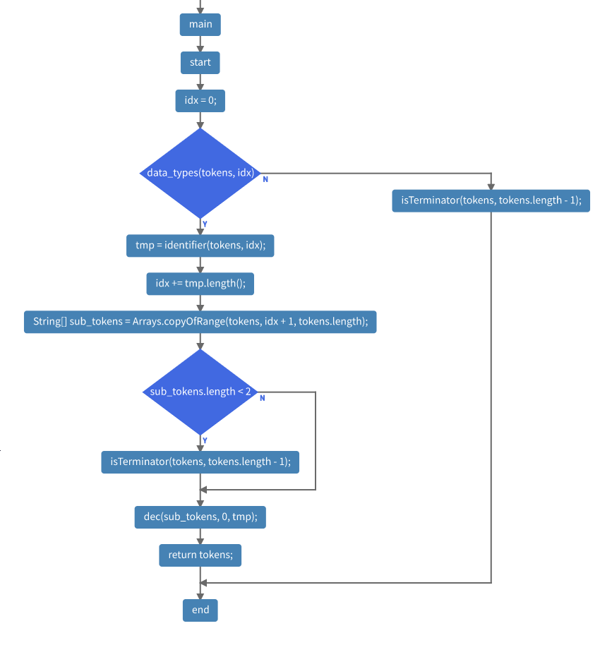
Syntax analyzer

Slide 7
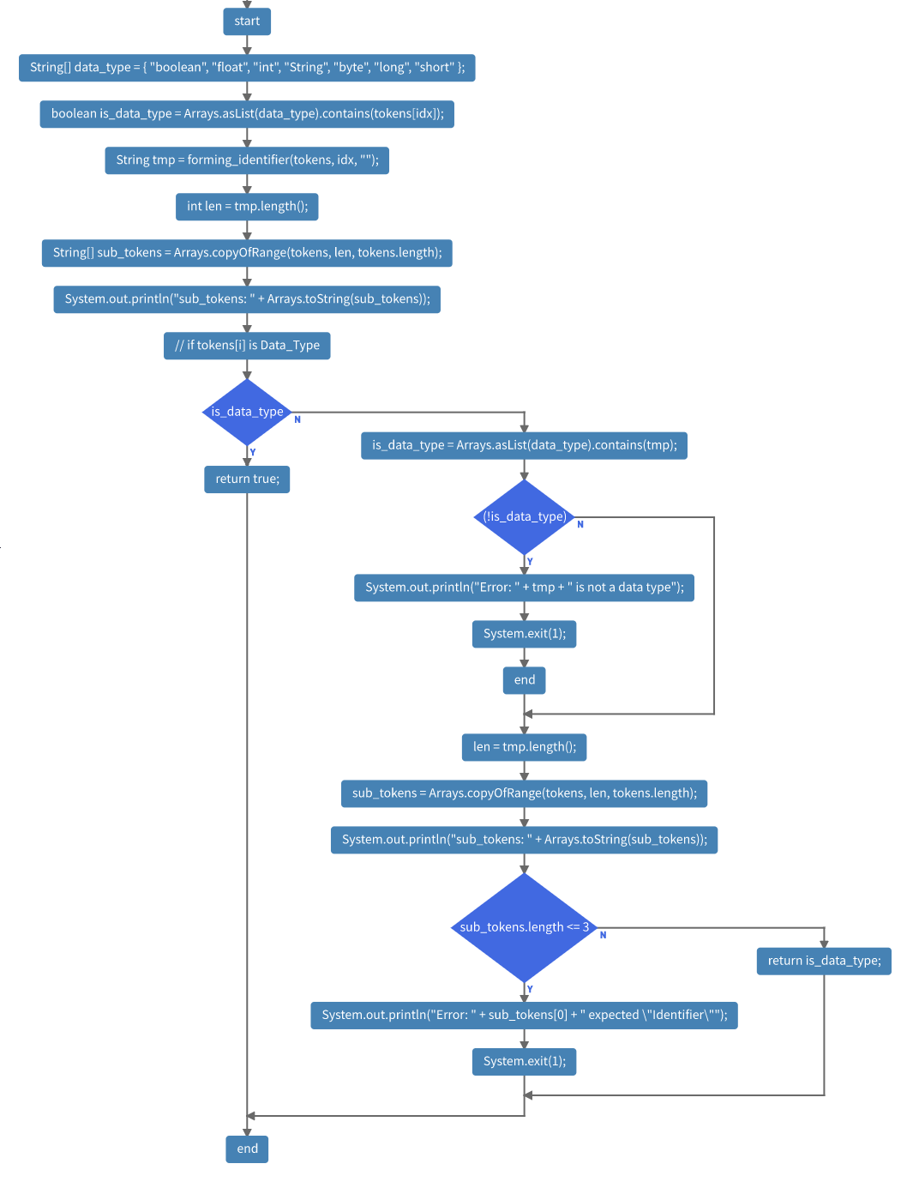
Data_type

Slide 8
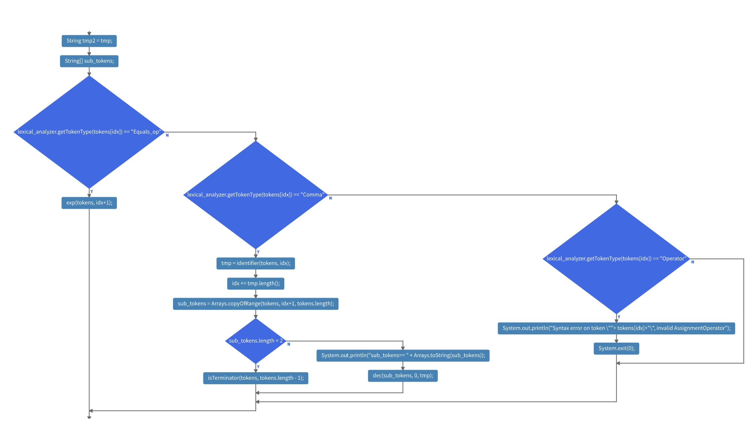
Declaration

Slide 9
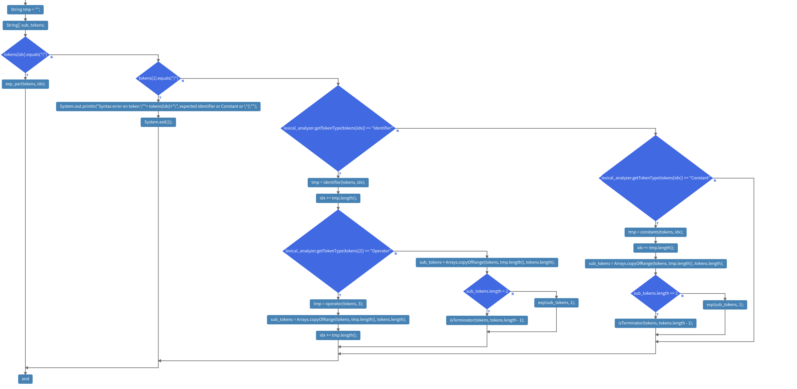
EXPression

Slide 10
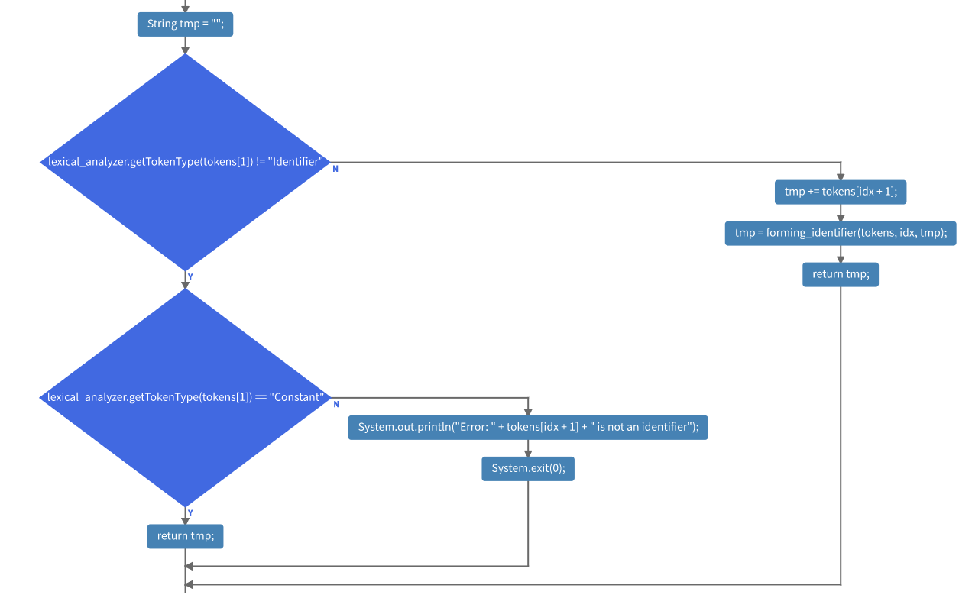
IIdentifier

Slide 11
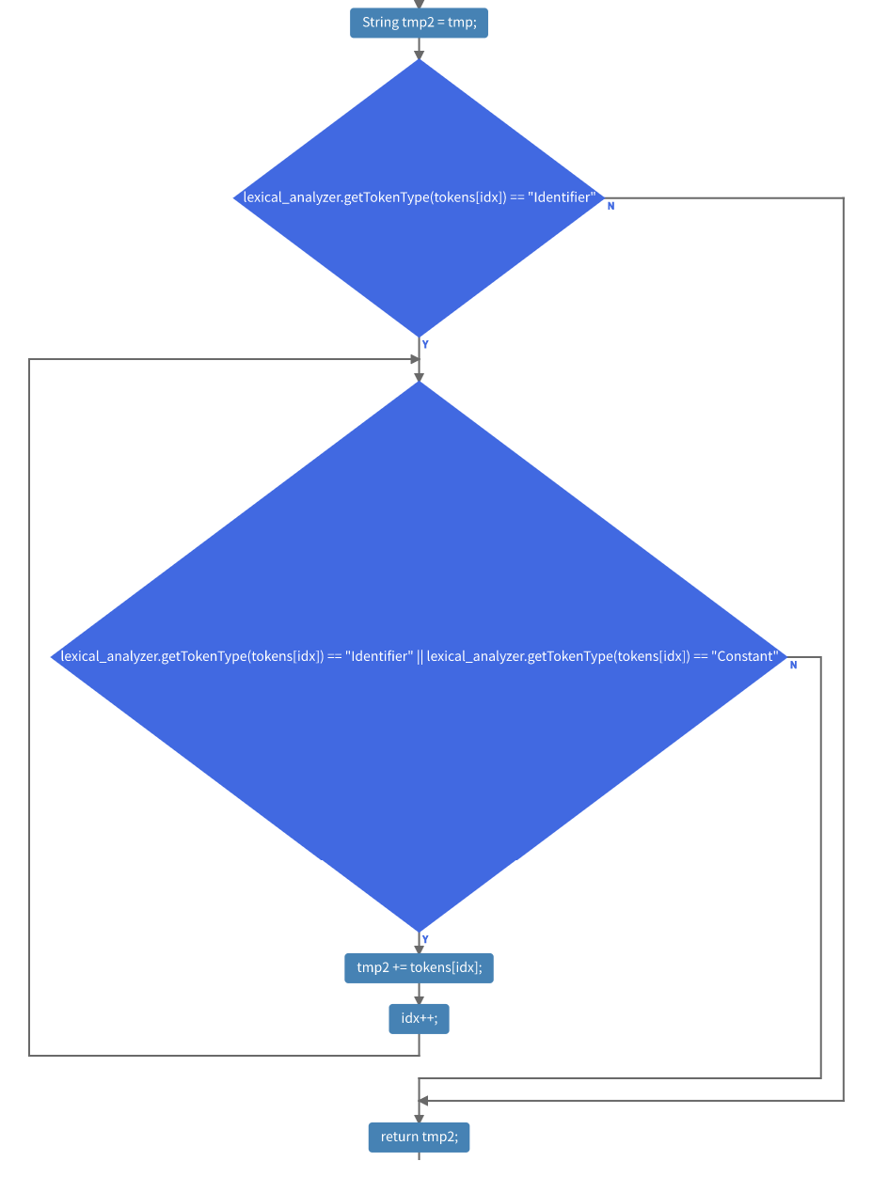
forming identifier

Slide 12
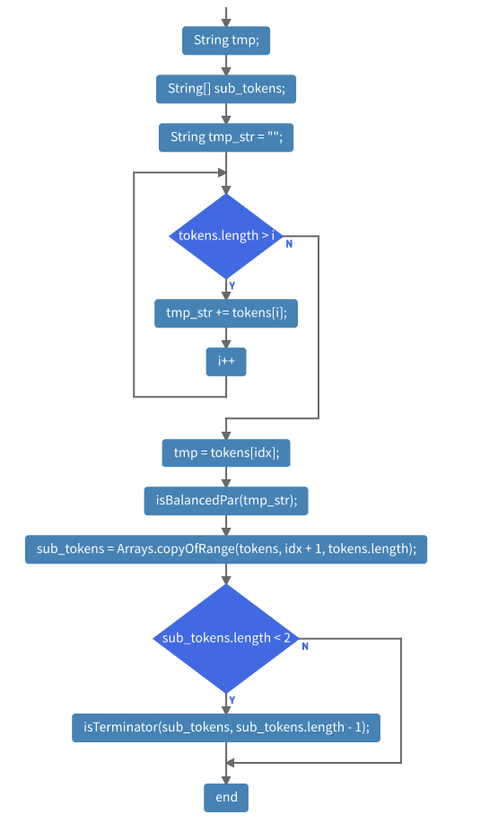
constants

Slide 13
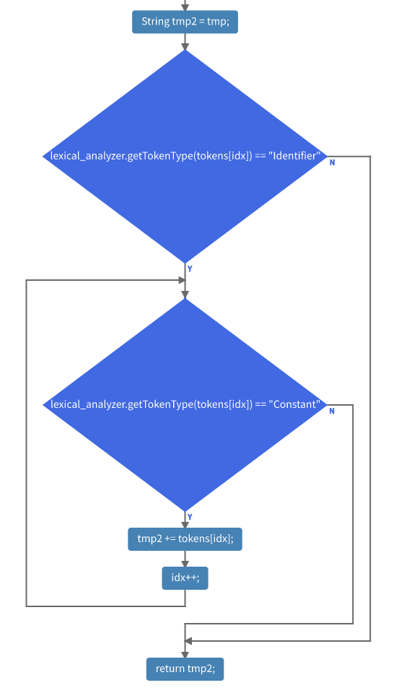
forming constant

Slide 14
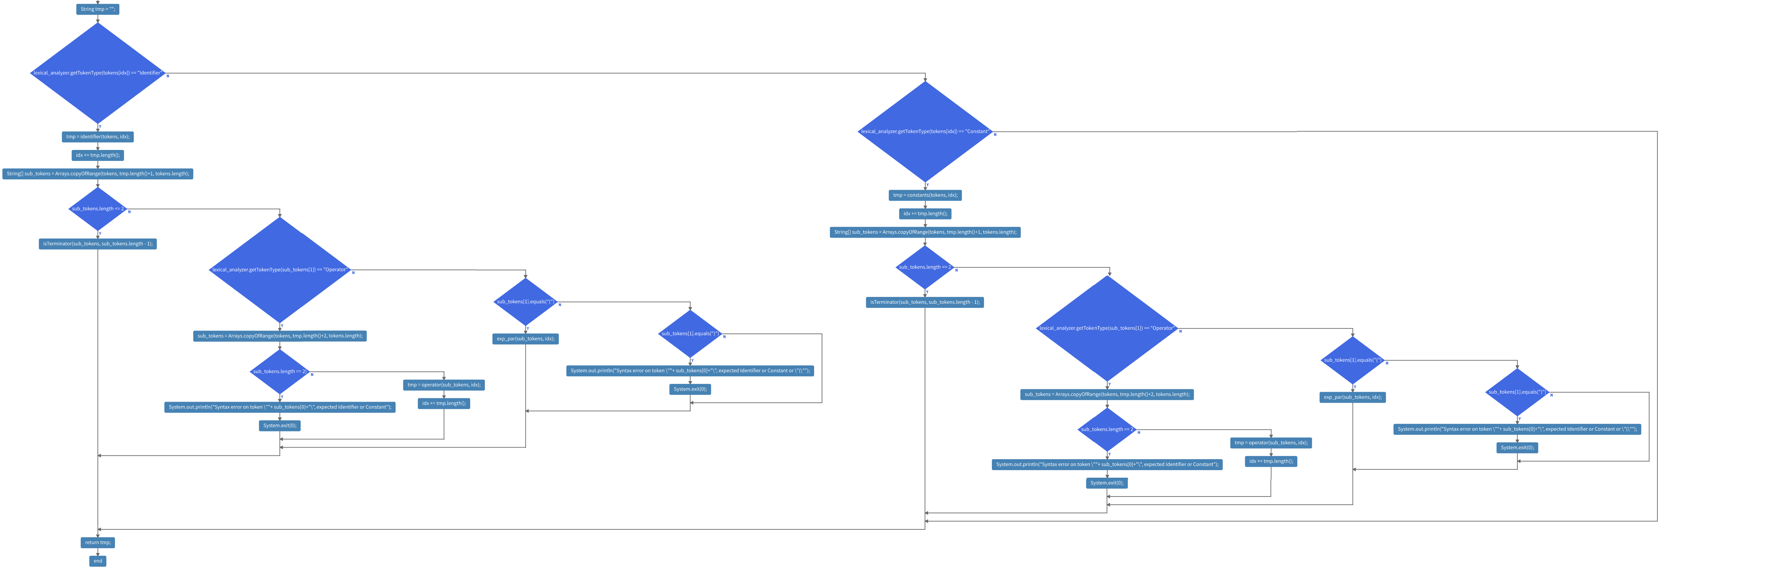
OPerator

Slide 15
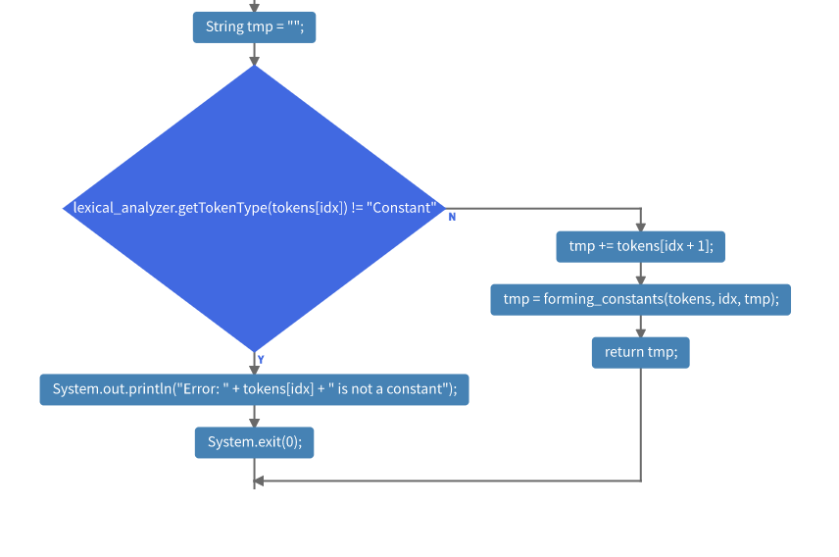
Exp Parenthesis

Slide 16
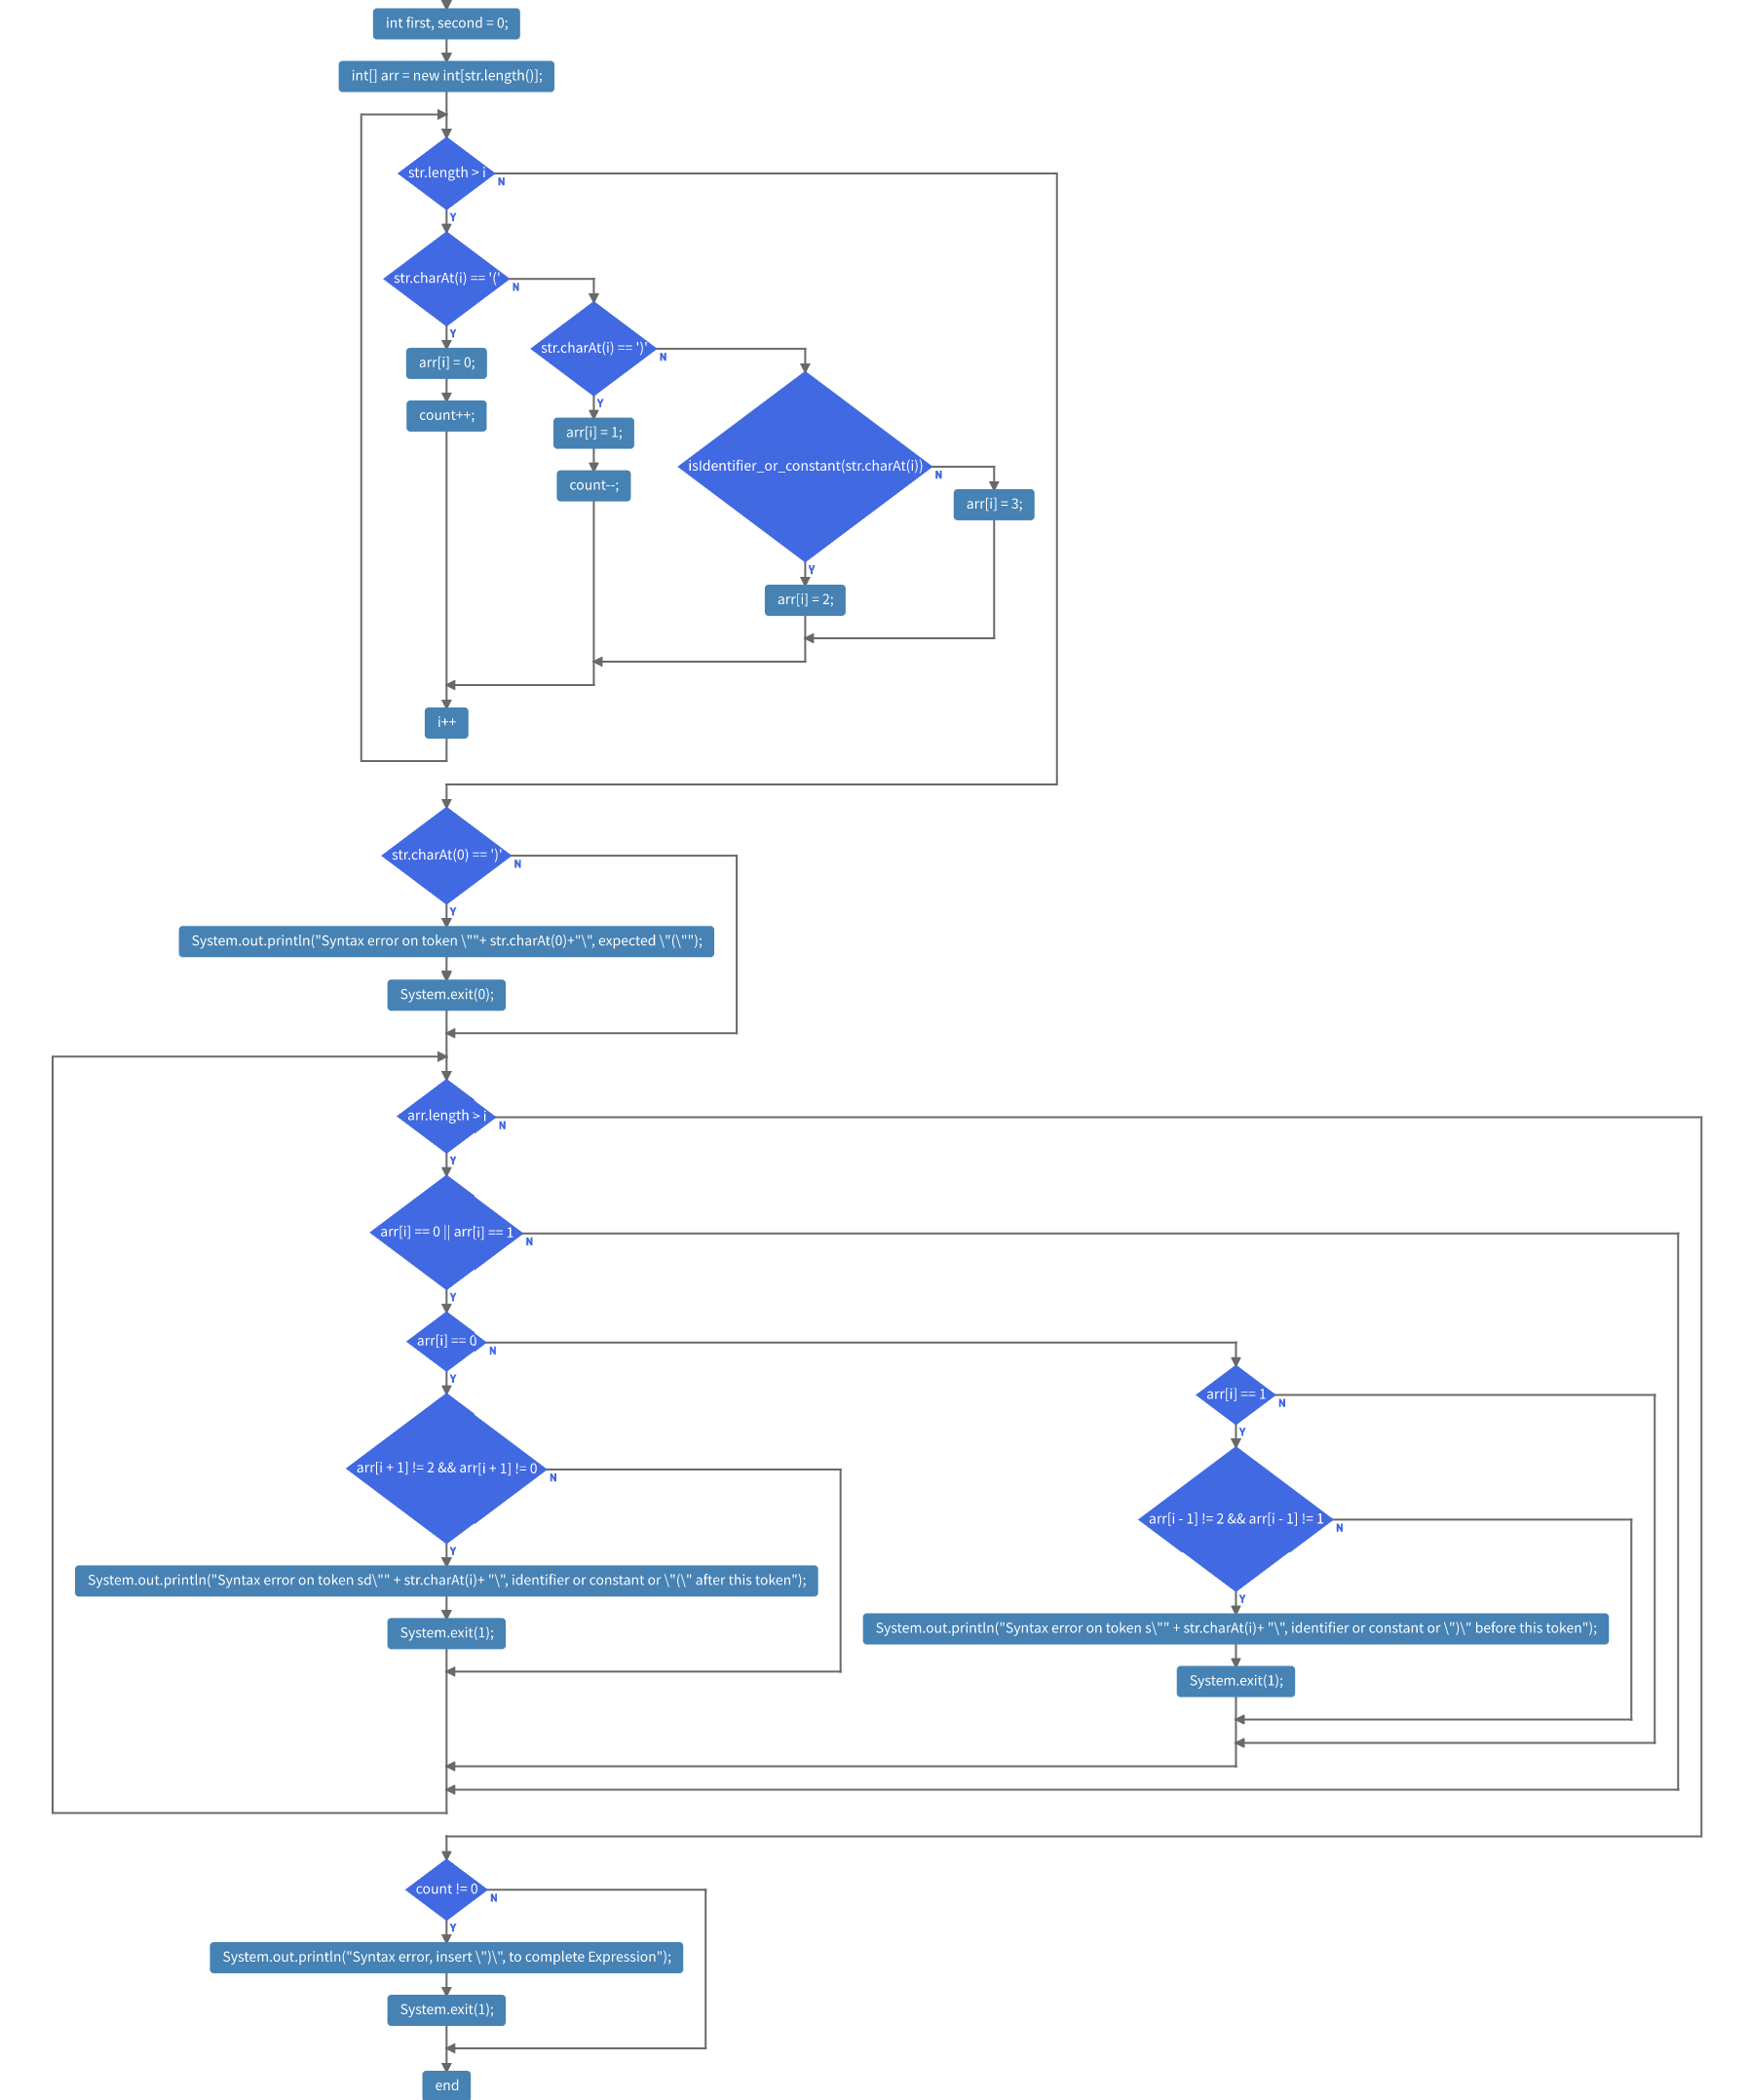
isbalanced

Slide 17
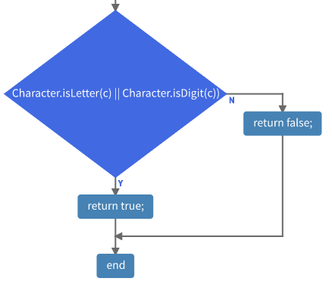
ischar

Slide 18
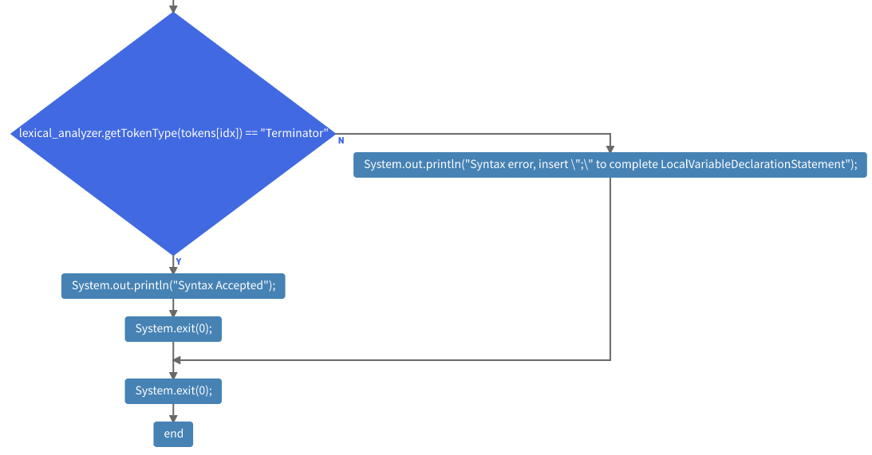
Terminator

Slide 19
FINAL Note

Slide 20
Thank you for listening Hope to pass this semester!

